Slide 1
Joys of JavaScript!
2018

Slide 2
Today’s Class

Slide 3
Objectives
In today’s class we’ll be covering:
JS fundamentals:
Arrays
Conditionals
Loops
Functions
Objects

Slide 4
Why JavaScript?

Slide 5
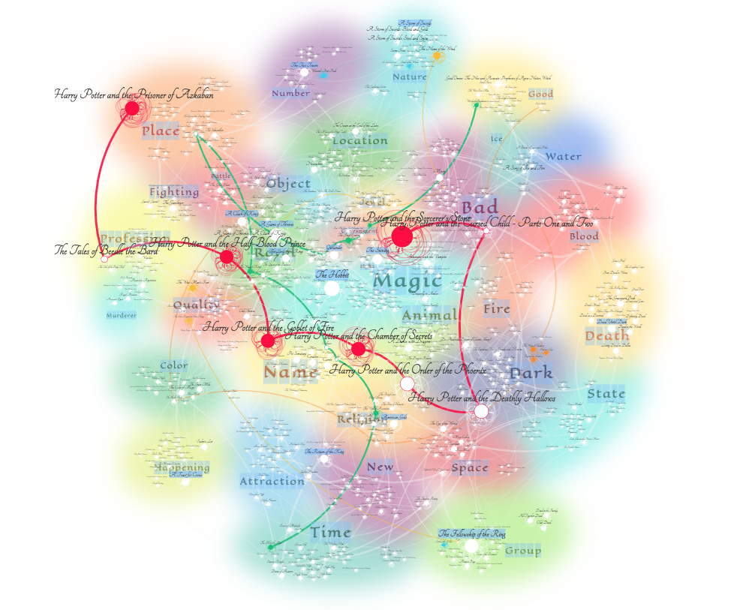
Why JavaScript? – Dynamic Visualizations

Slide 6
Why JavaScript? - IoT & the Cloud

Slide 7

Why JavaScript? – Machine Learning in the Browser!

Slide 8
How to Learn JavaScript

Slide 9

Your Brain on JavaScript…

Slide 10
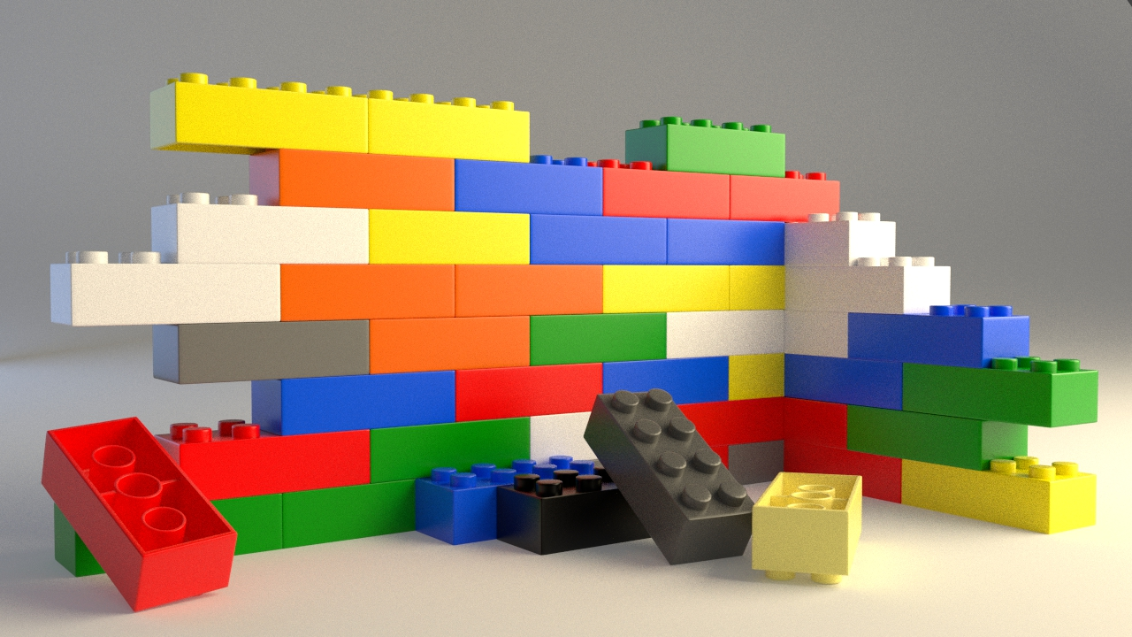
Start slow...

Slide 11
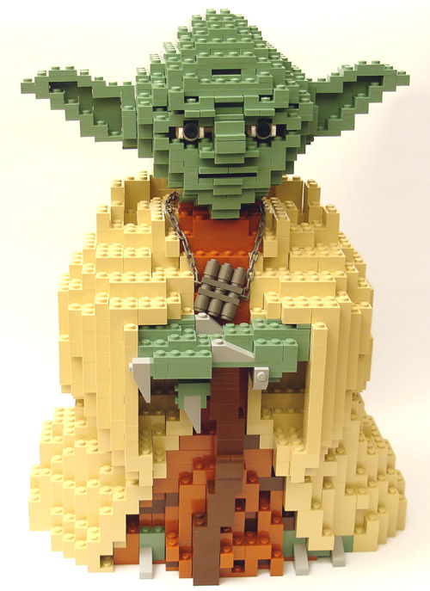
Eventually, this will be you...

Slide 12
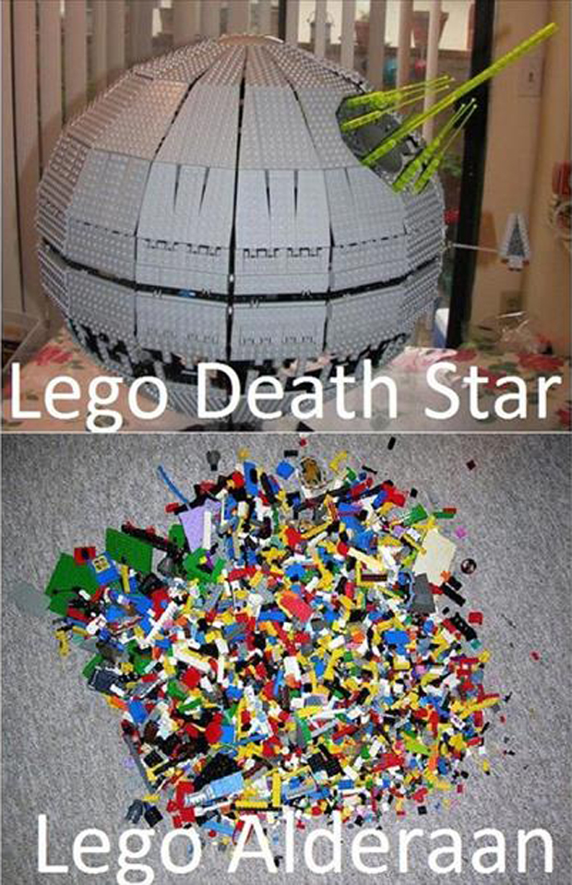
Just don’t become Lego Alderaan... Talk to us if you need extra help!

Slide 13
Overall Tips
Review Immediately: We’ll be building upon these concepts quickly. The firmer your grasp now, the better off you’ll be.
Re-do the exercises in class: Don’t just re-read! Actually spend the time to re-do them from scratch on your own.
Get Help: Come to office hours. Ask conceptual questions. Ask specific questions. Just keep asking questions!
Don’t be Afraid: You will get this. It will take time, but you will get this. Just keep at it. Patience will pay off.

